Slide 1
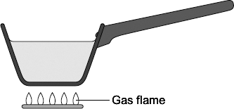

Conduction Practice Question
The diagram shows a metal pan being used to heat water.
Energy from the gas flame is transferred through the metal pan by conduction.
Explain the process of conduction through metals.
Key things to include:
Why do metals have delocalised electrons
What happens to electrons as they are heated
How do electrons enable heat to move through the metal
Answer
________________________________________________________________________________________________________________________________________________________________________________________________________________________________________________________________________________________________________________________________________________________________________________________
Link to video

Slide 2
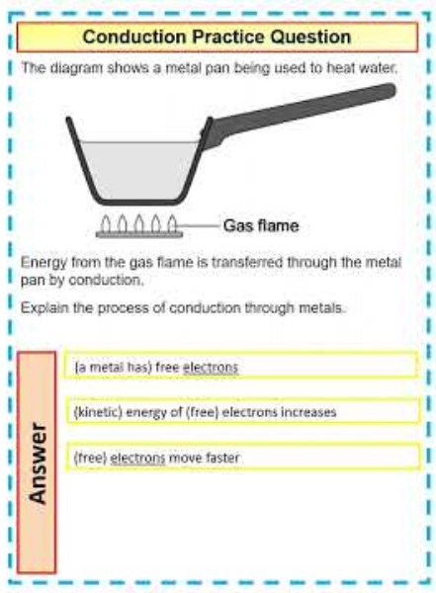
Conduction Practice Question

