Slide 1
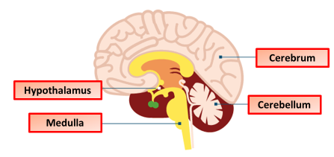

The Brain Question
Describe the structure and function of key parts of the brain
Key things to include:
What the function of the hypothalamus
What is the function of the medulla
What is the function of the cerebellum
_______________________________________________________________________________________________________________________________________________________________________________________________________________________________________________________________________________________________________________________________________________________________________________________________________________________________________
Answer
Link to video

