Slide 1
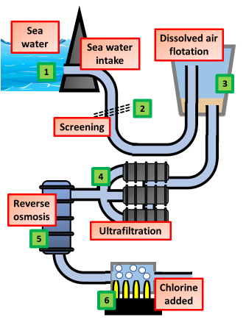

Desalination Question
The diagram shows how potable water is produced from sea water
Video link
What is desalination?
What are two common methods of desalination?
Why is desalination mainly used in some countries?
Why is desalination not used everywhere?

