Slide 1
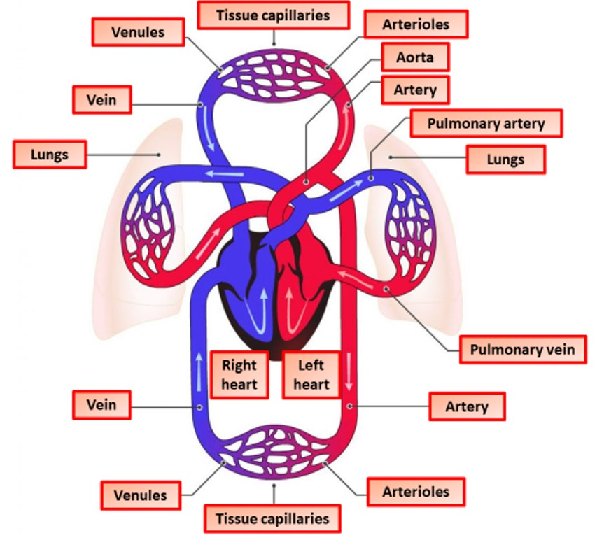

Double Closed Circulation Question
The diagram below shows double closed circulation
Explain the key features of a double closed circulatory system.
________________________________________________________________________________________________________________________________________________________________________________________________________________________________________________________________________________________________________________________________________________________________________________________________________________________________________________________________________________________________________________________________________________________________________________________________________________________________________________________________________________________________________________________________________________________________________________
Answer
Link to video

