Slide 1
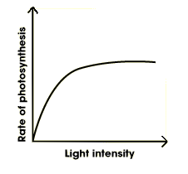

Photosynthesis Graph Question
A graph shows how the rate of photosynthesis changes with increasing light intensity. The graph rises quickly and then levels off.
Use the graph to explain which factor is limiting at low light intensity and why the graph levels off at high light intensity.
_______________________________________________________________________________________________________________________________________________________________________________________________________________________________________________________________________________________________________________________________________________________________________________________________________________________________________
Answer
Link to video

