Slide 1
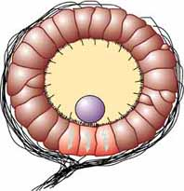
Statocyst Sensory Receptor Practice Question
The diagram below shows a statocyst sensory receptor
Describe the structure and function of a statocyst as a sensory receptor and explain its role in detecting balance.
Sensory hairs
Epithelial cell
Mineral mass
Neurone
________________________________________________________________________________________________________________________________________________________________________________________________________________________________________________________________________________________________________________________________________________________________________________________________________________________________________________________________________________________________________________________________________________________________________________________________________________________________________________________________________________________________________________________________________________________________________________
Answer
Link to video

