Slide 1
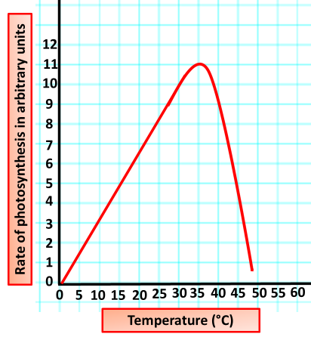

Temperature as a Limiting Factor Question
Explain why increasing temperature affects the rate of glucose production in photosynthesis.
____________________________________________________________________________________________________________________________________________________________________________________________________________________________________________________________________________________________________________________________________________________________________________________________________________________________________________________________________________________________________________________________________________________________________________________
Answer
Video link

