Slide 1
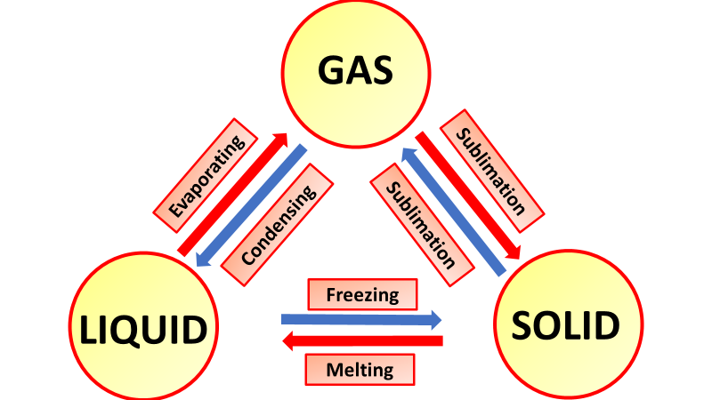

Change of State Question
Explain what happens to the particles in a substance when it changes state from a solid to a liquid and from a liquid to a gas.
Key things to include:
What effect does temperature have on particles
What happens to particles in a solid
What happens to particles in a liquid
________________________________________________________________________________________________________________________________________________________________________________________________________________________________________________________________________________________________________________________________________________________________________________________________________________________________________
Answer
Link to video

