Slide 1
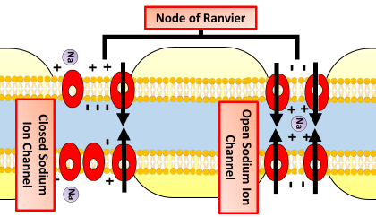

Node of Ranvier Question
Explain the role of the nodes of Ranvier in the conduction of nerve impulses along a myelinated neurone.
____________________________________________________________________________________________________________________________________________________________________________________________________________________________________________________________________________________________________________________________________________________________________________________________________________________________________________________________________________________________________________________________________________________________________________________
Answer
Video link

