Slide 1
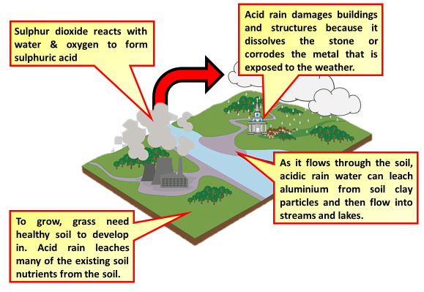

Acid Rain Practice Question
Fossil fuels are burned in car engines. Explain how reducing the amount of sulfur in fossil fuels reduces the erosion of limestone.
Key things to include:
What gas causes acid rain
How is acid rain formed
What does acid rain react with
______________________________________________________________________________________________________________________________________________________________________________________________________________________________________________________________________________________________________________________________________________________________________________________________________________________________________________________________________________________
Answer
Link to video

Slide 2
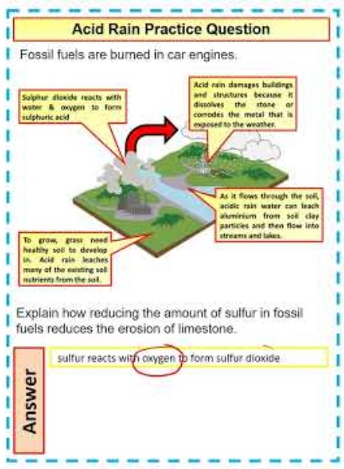
Acid Rain Practice Question

