Slide 1
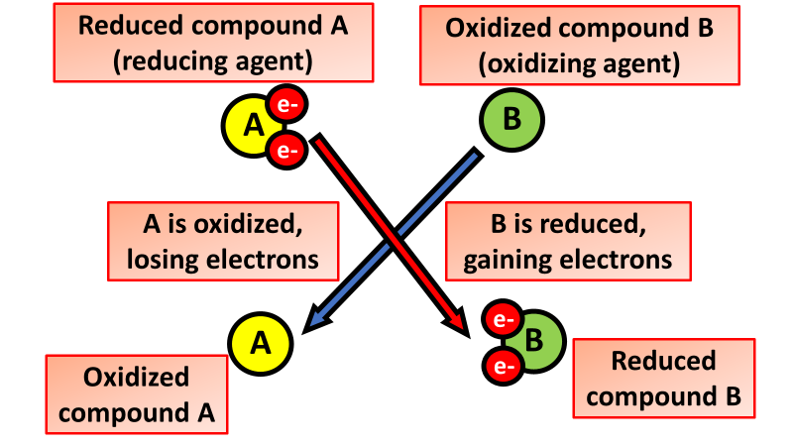

Reduction of Metals Question
The diagram shows what happens during a redox reaction
Video Link
What is reduction?
What happens when iron oxide is reduced?
Which substance is often used to remove oxygen from metal ores in a blast furnace?
Is reduction the opposite of oxidation?

