Slide 1
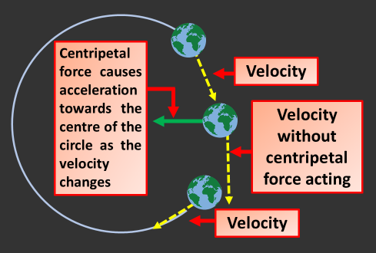

Orbital Motion Question
Explain how orbital motion of satellites is maintained and what happens if the speed of a satellite changes.
Key things to include:
What is centripetal force
How does a satellite orbit
How does it’s velocity change
_______________________________________________________________________________________________________________________________________________________________________________________________________________________________________________________________________________________________________________________________________________________________________________________________________________________________________
Answer
Link to video

