Slide 1
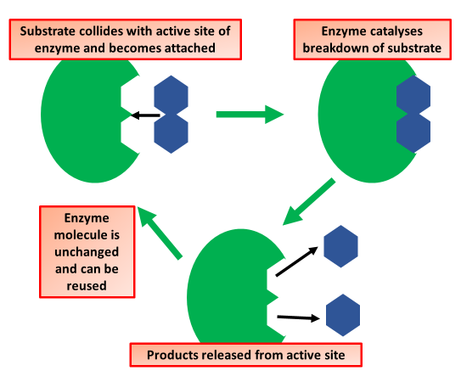

Lock & Key Mechanism Question
The diagram shows the lock and key mechanism:
Video link
What does the lock and key model describe?
What part of the enzyme does the substrate bind to?
Why is the lock and key model used to describe enzymes?
What happens if the enzyme's shape changes?

