Slide 1
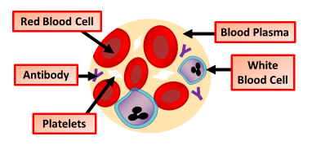

Blood Question
The diagram shows what we find in blood :
What is the main function of red blood cells?
Which component of blood helps with clotting?
What is the liquid part of blood called?
Which type of blood cell fights infections?
Video link

