Slide 1
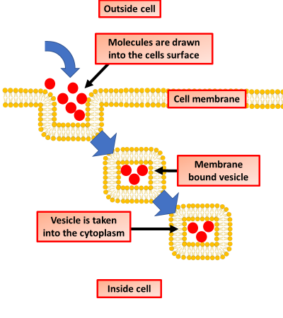

Endocytosis Question
Describe the process of endocytosis and explain its role in cells.
___________________________________________________________________________________________________________________________________________________________________________________________________________________________________________________________________________________________________________________________________________________________________________________________________________________________________________________________________________________________________________________________________________________________________________________________________________________________________
Answer
Link to video

