Slide 1
Carbon Cycle Question
The leaves fall off many trees in autumn.
The dead leaves contain carbon compounds and nitrogen compounds.
Describe how carbon and nitrogen in compounds in the leaves are recycled and used by living trees.
You should include a description of:
• how the leaves are broken down
• how substances are taken in and used by the trees.
Key things to include:
What the role of micro-organisms is
The role of respiration
How plants take in carbon dioxide
What plants use nitrates for
______________________________________________________________________________________________________________________________________________________________________________________________________________________________________________________________________________________________________________________________________________________________________________________________________________________________________________________________________________________
Answer
Link to video

Slide 2
Carbon Cycle Question

Slide 3
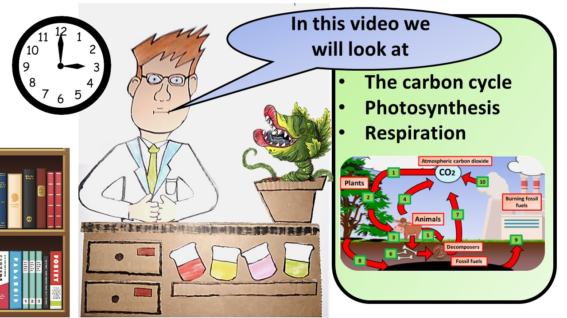
Click here to access my youtube videos
Resources that this activity would work well with
Lesson on TES
Lesson on TPT
Follow me on social media to stay in touch
Keep up to date with my new content:

