Slide 1
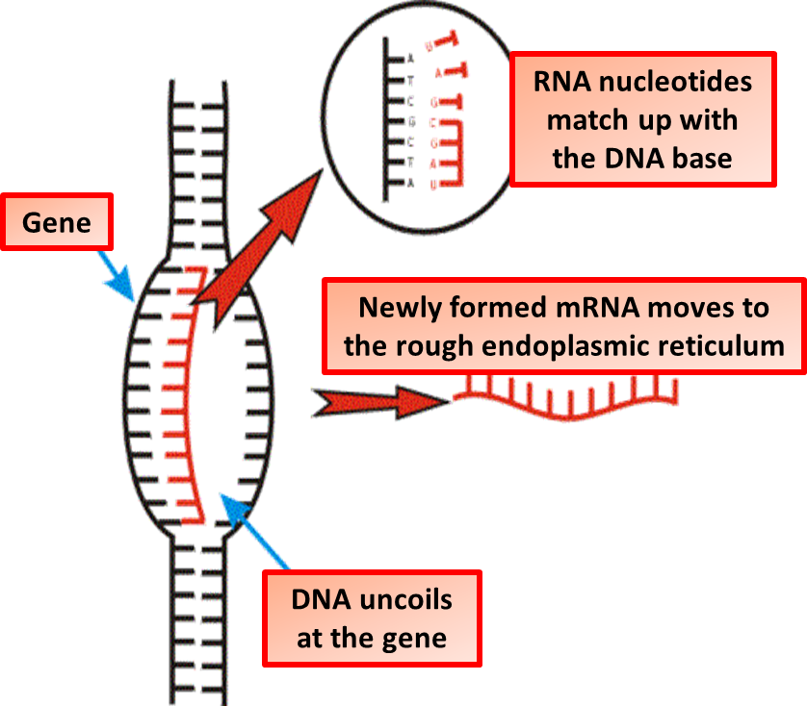

Transcription Question
The diagram shows the process of transcription. Describe the process of transcription in protein synthesis
____________________________________________________________________________________________________________________________________________________________________________________________________________________________________________________________________________________________________________________________________________________________________________________________________________________________________________________________________________________________________________________________________________________________________________________
Answer
Video link

