Slide 1

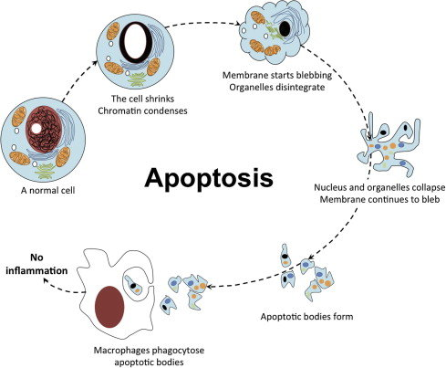

The Great Biology Pubish Quiz
Apoptosis

Slide 2

The Great Biology Pubish Quiz
Apoptosis
What is apoptosis?
A
Cell Division
Cell Growth
B
C
Cell Death
D
Cell Fusion

Slide 3
The Great Biology Pubish Quiz
Apoptosis
Apoptosis is a form of:
A
Osmosis
Metabolism
B
C
Necrosis
D
Programmed action

Slide 4
The Great Biology Pubish Quiz
Apoptosis
Which type of enzymes are involved in apoptosis?
A
Ligases
Caspases
B
C
Kinases
D
Polymerases

Slide 5
The Great Biology Pubish Quiz
Apoptosis
Which organelle plays a key role in initiating apoptosis?
A
Nucleus
Ribosome
B
C
Mitochondrion
D
Golgi

Slide 6
The Great Biology Pubish Quiz
Apoptosis
Apoptosis helps shape the developing:
A
Skin
B
Lungs
C
Brain
D
Embryo

Slide 7
The Great Biology Pubish Quiz
Apoptosis
Failure of apoptosis can lead to:
A
Healing
Cancer
B
C
Ageing
D
Anaemia

Slide 8

The Great Biology Pubish Quiz
Apoptosis
Question 1
C
Question 2
D
Question 3
B
Question 4
C
Question 5
D
Question 6
B

