Slide 1

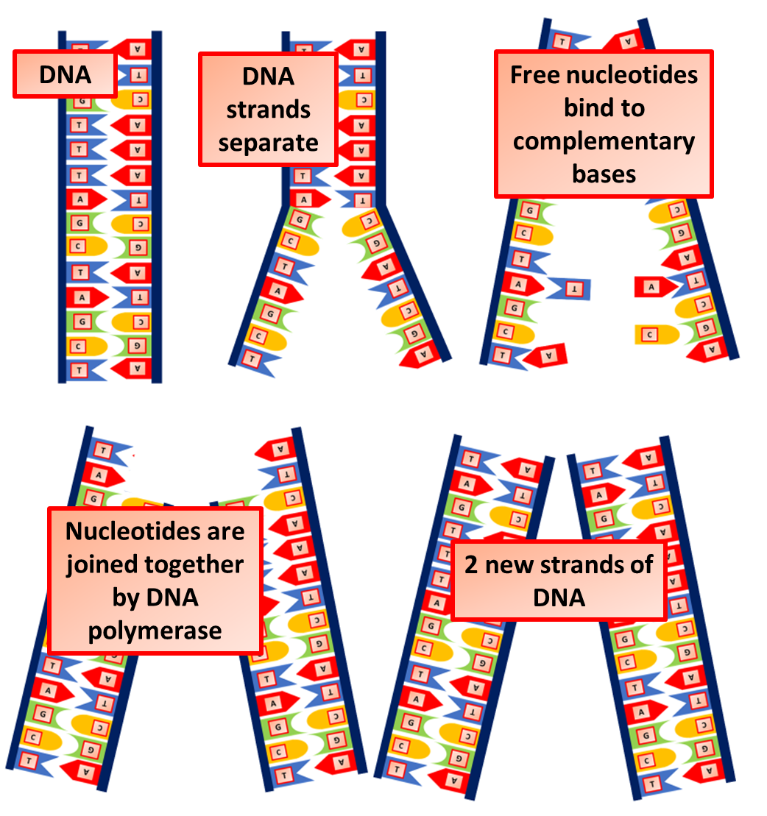

The Great Biology Pubish Quiz
DNA Replication

Slide 2

The Great Biology Pubish Quiz
DNA Replication
Which enzyme unwinds the DNA helix?
A
Helicase
Polymerase
B
C
Ligase
D
Primase

Slide 3
The Great Biology Pubish Quiz
DNA Replication
Which enzyme adds new nucleotides during DNA replication?
A
Helicase
Polymerase
B
C
Ligase
D
Primase

Slide 4
The Great Biology Pubish Quiz
DNA Replication
What type of replication is described by the Watson-Crick model?
A
Conservative
Dispersive
B
C
Semiconservative
D
Random

Slide 5
The Great Biology Pubish Quiz
DNA Replication
Which enzyme synthesizes RNA primers?
A
Helicase
Polymerase
B
C
Ligase
D
Primase

Slide 6
The Great Biology Pubish Quiz
DNA Replication
Which enzyme joins Okazaki fragments on the lagging strand?
A
Ligase
Primase
B
C
Polymerase
D
Helicase

Slide 7
The Great Biology Pubish Quiz
DNA Replication
Which activity of DNA polymerase corrects errors during replication?
A
Synthesis
B
Proofreading
C
Unwinding
D
Binding

Slide 8

The Great Biology Pubish Quiz
DNA Replication
Question 1
A
Question 2
B
Question 3
C
Question 4
D
Question 5
A
Question 6
B

