Slide 1
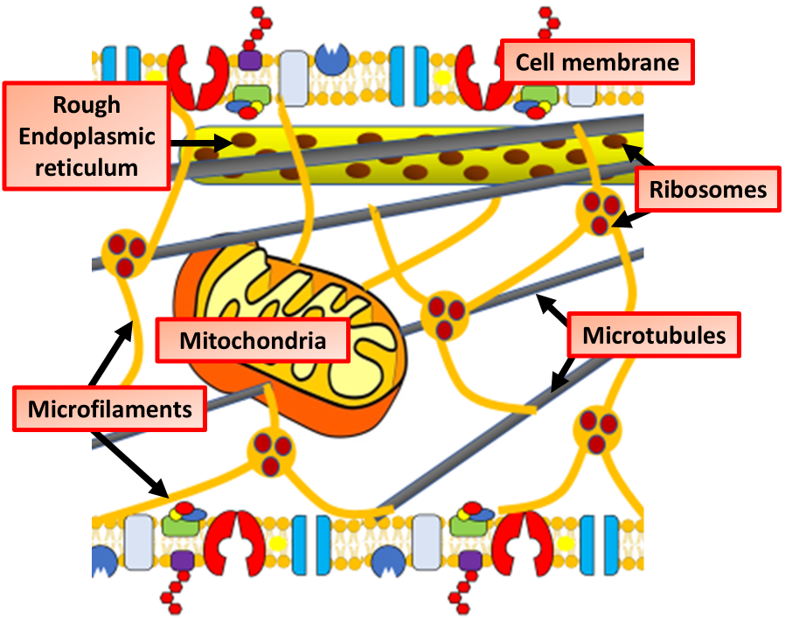

Cytoskeleton Question
The diagram shows the structure of the cytoskeleton. Describe the structure and function of the cytoskeleton in eukaryotic cells.
____________________________________________________________________________________________________________________________________________________________________________________________________________________________________________________________________________________________________________________________________________________________________________________________________________________________________________________________________________________________________________________________________________________________________________________
Answer
Video link

