Slide 1
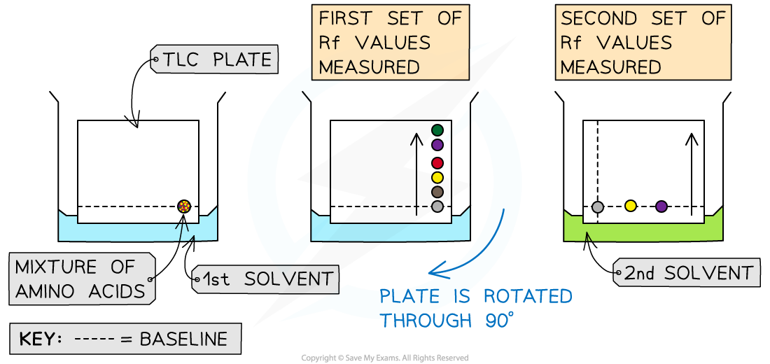

Identification of Amino Acids by Paper Chromatography Question
Describe how you would use paper chromatography to identify amino acids in a mixture.
____________________________________________________________________________________________________________________________________________________________________________________________________________________________________________________________________________________________________________________________________________________________________________________________________________________________________________________________________________________________________________________________________________________________________________________
Answer
Link to video

