Slide 1
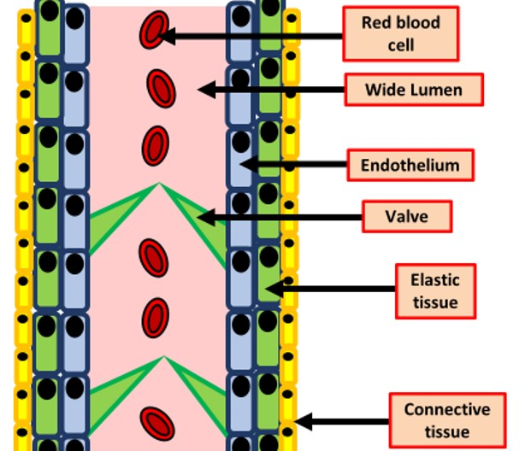

Veins Question
The diagram below shows the structure of a vein
Explain how veins are adapted to their function of returning blood to the heart
________________________________________________________________________________________________________________________________________________________________________________________________________________________________________________________________________________________________________________________________________________________________________________________________________________________________________________________________________________________________________________________________________________________________________________________________________________________________________________________________________________________________________________________________________________________________________________
Answer
Link to video

