Slide 1
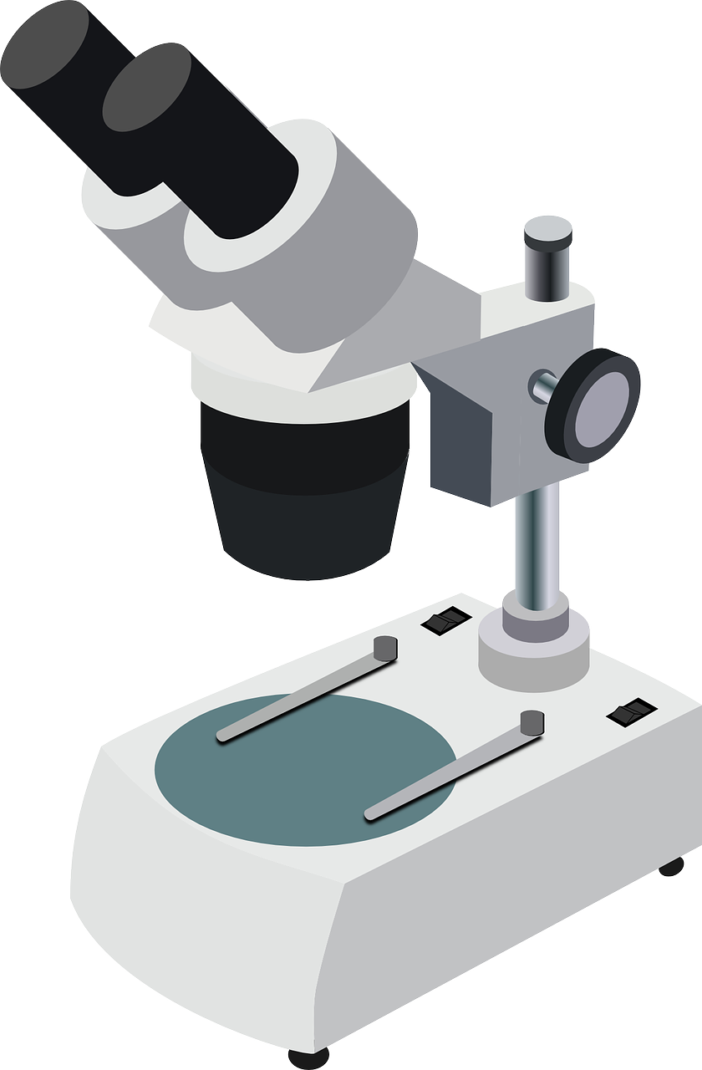

Limitations of Light Microscopes Question
Explain the limitations of using a light microscope to observe cellular structures, and describe how these limitations affect the interpretation of biological specimens.
____________________________________________________________________________________________________________________________________________________________________________________________________________________________________________________________________________________________________________________________________________________________________________________________________________________________________________________________________________________________________________________________________________________________________________________
Answer
Link to video

