Slide 1
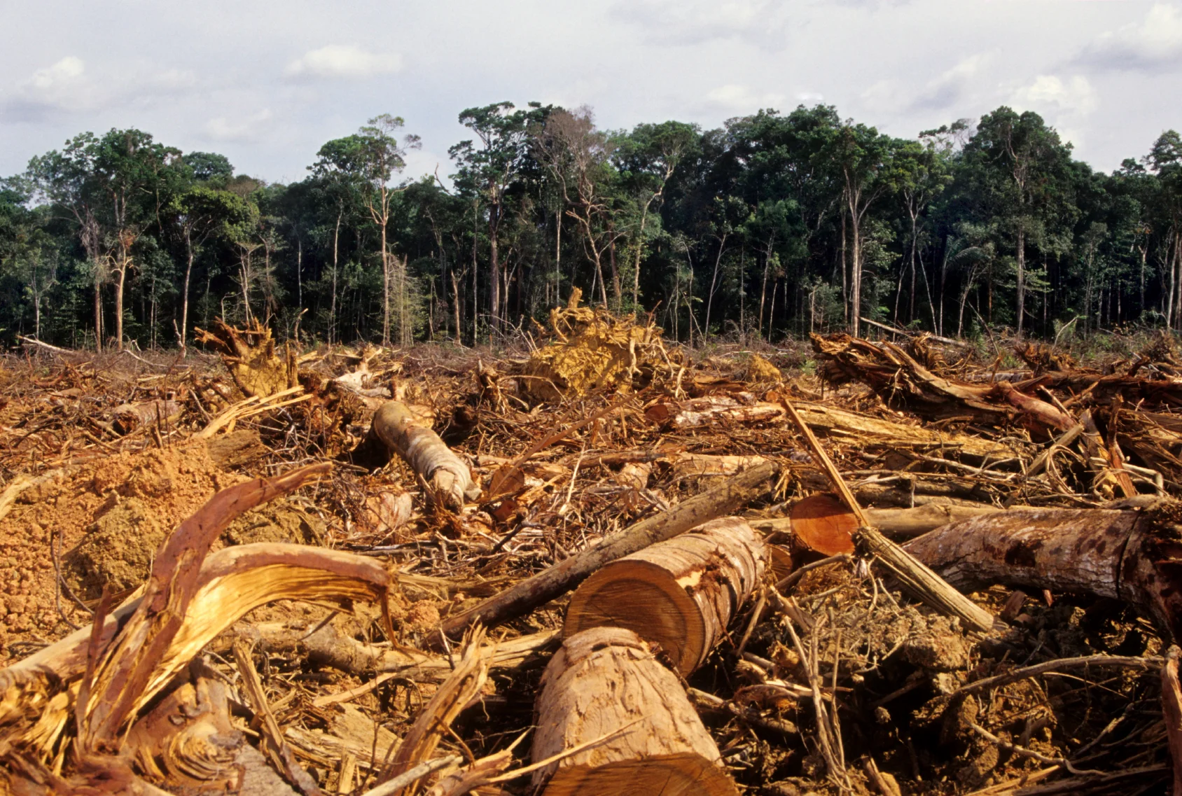

Deforestation Question
The diagram below shows key things about deforestation
Video Link
What is deforestation?
How does deforestation affect carbon dioxide levels in the atmosphere?
What is one major reason forests are cut down?
How does deforestation affect animals?

