Slide 1
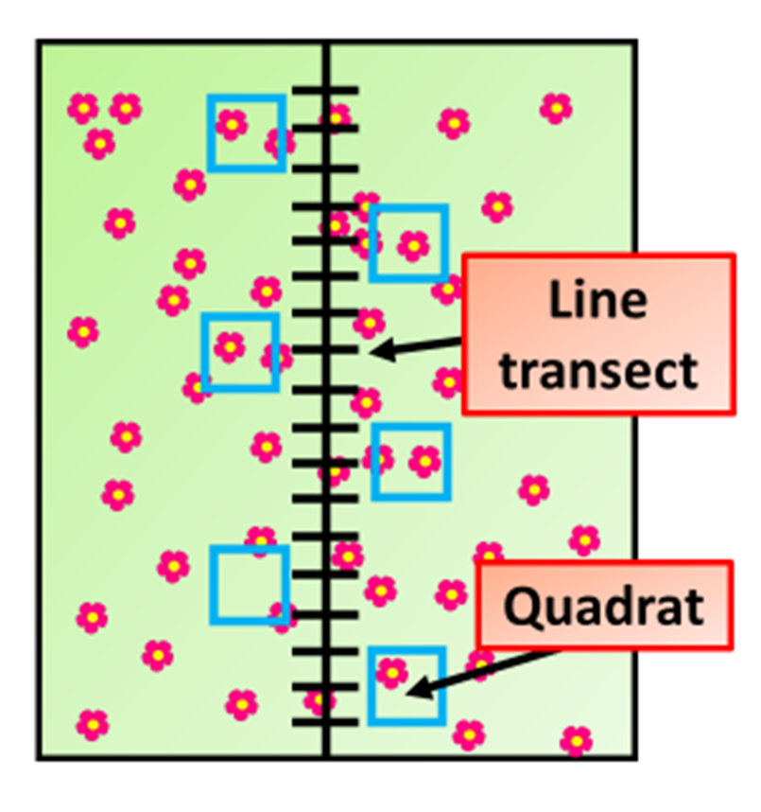
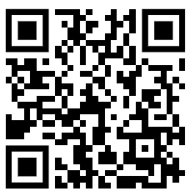
Sampling an Area Practice Question
A student is asked to investigate the population size of daisies in trampled and un-trampled parts of a school field. Some of the equipment they were provided with is shown below:
a 0.5 m2 quadrat
a 30 m tape measure
a clipboard
a pen
paper
Describe how they could carry out this investigation
Key things to include:
Dependent variables
Independent variables
Control variables
_______________________________________________________________________________________________________________________________________________________________________________________________________________________________________________________________________________________________________________________________________________________________________________________________________________________________________
Answer
Link to video

Slide 2
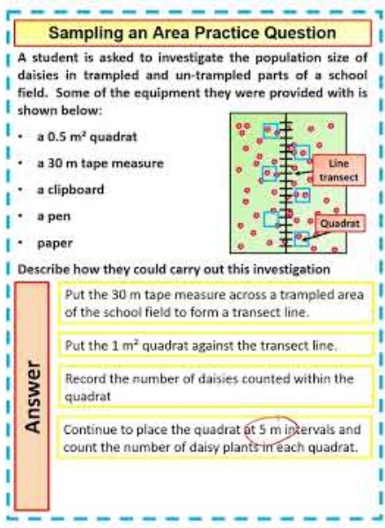
Sampling an Area Practice Question

