Slide 1
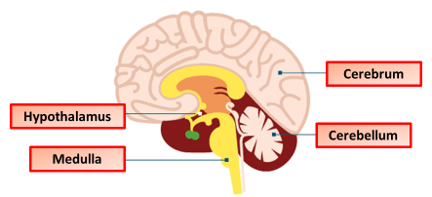

The Brain Practice Question
The diagram below shows the brain
Describe the structure and function of four major parts of the brain.
________________________________________________________________________________________________________________________________________________________________________________________________________________________________________________________________________________________________________________________________________________________________________________________________________________________________________________________________________________________________________________________________________________________________________________________________________________________________________________________________________________________________________________________________________________________________________________
Answer
Link to video

