Slide 1
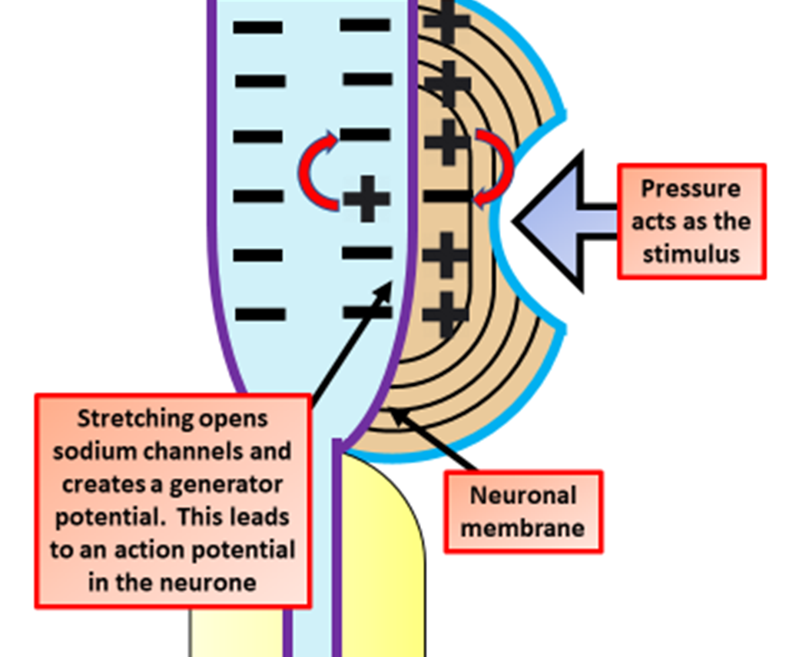

Pacinian Corpuscle Question
Describe how a Pacinian corpuscle converts mechanical pressure into a nervous impulse.
____________________________________________________________________________________________________________________________________________________________________________________________________________________________________________________________________________________________________________________________________________________________________________________________________________________________________________________________________________________________________________________________________________________________________________________
Answer
Video link

