Slide 1
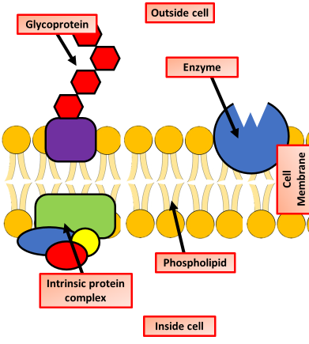

Membrane Proteins Question
Describe the differences between intrinsic and extrinsic proteins in the cell membrane.
___________________________________________________________________________________________________________________________________________________________________________________________________________________________________________________________________________________________________________________________________________________________________________________________________________________________________________________________________________________________________________________________________________________________________________________________________________________________________
Answer
Link to video

