Slide 1

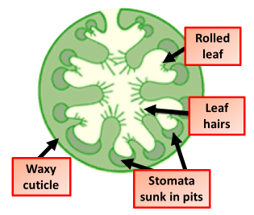

The Great Biology Pubish Quiz
Xerophytes

Slide 2

The Great Biology Pubish Quiz
Xerophytes
What type of environment do xerophytes typically inhabit?
A
Wetlands
Deserts
B
C
Forests
D
Oceans

Slide 3
The Great Biology Pubish Quiz
Xerophytes
Which of the following is a common adaptation in xerophytes?
A
Broad
Rolled
B
C
Soft
D
Glossy

Slide 4
The Great Biology Pubish Quiz
Xerophytes
What is the purpose of sunken stomata in xerophytes?
A
Growth
Photosynthesis
B
C
Transpiration
D
Retention

Slide 5
The Great Biology Pubish Quiz
Xerophytes
Thick cuticles in xerophytes help reduce:
A
Water
Nutrients
B
C
Light
D
Starch

Slide 6
The Great Biology Pubish Quiz
Xerophytes
What type of tissue is often abundant in xerophyte stems for water storage?
A
Meristem
B
Xylem
C
Collenchyma
D
Parenchyma

Slide 7
The Great Biology Pubish Quiz
Xerophytes
What structure helps trap moist air near the leaf surface in some xerophytes?
A
Trichomes
Veins
B
C
Nodes
D
Lenticels

Slide 8

The Great Biology Pubish Quiz
Xerophytes
Question 1
B
Question 2
B
Question 3
D
Question 4
A
Question 5
D
Question 6
A

