Slide 1


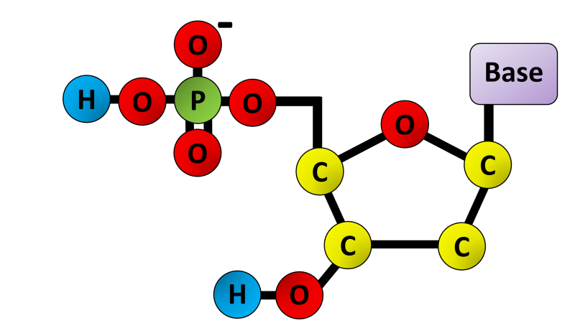
The Great Biology Pubish Quiz
Nucleotides

Slide 2

The Great Biology Pubish Quiz
Nucleotides
What are the three components of a nucleotide?
A
Phosphate group, amino acid, ribose sugar
Phosphate group, deoxyribose sugar, nitrogenous base
B
C
Nitrogenous base, ribose sugar, lipid
D
Amino acid, phosphate group, deoxyribose sugar

Slide 3
The Great Biology Pubish Quiz
Nucleotides
Which of the following is a purine nitrogenous base?
A
Adenine
Cytosine
B
C
Thymine
D
Uracil

Slide 4
The Great Biology Pubish Quiz
Nucleotides
What type of bond connects nucleotides in a DNA strand?
A
Phosphodiester bond
Hydrogen bond
B
C
Peptide bond
D
Ionic bond

Slide 5
The Great Biology Pubish Quiz
Nucleotides
Which sugar is found in RNA nucleotides?
A
Deoxyribose
Ribose
B
C
Glucose
D
Fructose

Slide 6
The Great Biology Pubish Quiz
Nucleotides
What distinguishes thymine from uracil?
A
Thymine is found in RNA, while uracil is in DNA
Thymine is a purine, while uracil is a pyrimidine
B
C
Thymine is paired with guanine in DNA
D
Thymine contains a methyl group absent in uracil

Slide 7
The Great Biology Pubish Quiz
Nucleotides
What base does guanine pair with in DNA?
A
Adenine
B
Thymine
C
Cytosine
D
Uracil

Slide 8

The Great Biology Pubish Quiz
Nucleotides
Question 1
B
Question 2
A
Question 3
A
Question 4
B
Question 5
D
Question 6
C

