Slide 1
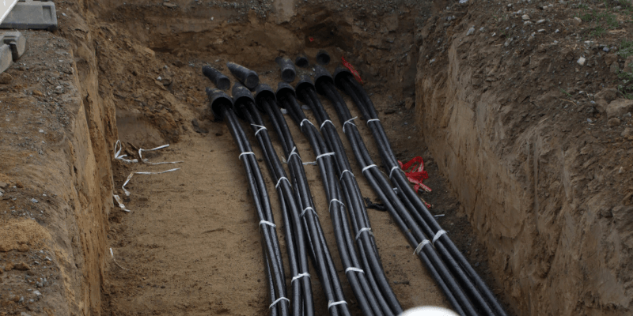
Overhead Power Lines Question
Underground power lines are cables buried below the earth's surface to transmit electricity, providing a concealed and protected alternative to overhead lines.
Discuss the advantages and disadvantages of using underground power cables for transmitting electricity over long distances.
________________________________________________________________________________________________________________________________________________________________________________________________________________________________________________________________________________________________________________________________________________________________________________________________________________________________________________________________________________________________________________________________________________________________________
Answer

