Slide 1
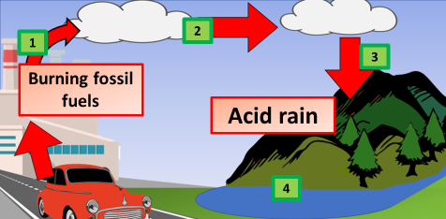

Acid Rain Question
The diagram shows how acid rain is formed
Video link
What gases cause acid rain?
How is acid rain formed?
What are the effects of acid rain on the environment?
How can acid rain be reduced?

