Slide 1
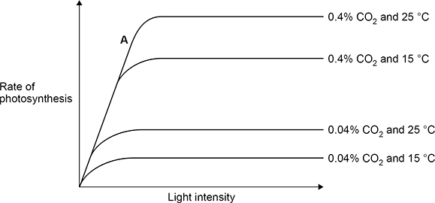

Increasing Photosynthesis Question
The graph below shows how the rate of photosynthesis is affected by light, carbon dioxide and temperature. Explain the effect of increasing temperature and increasing carbon dioxide concentration on the rate of photosynthesis
Increasing temperature increases the rate of photosynthesis up to an optimum, due to faster enzyme activity.
Beyond the optimum temperature, enzymes can denature, causing the rate to decrease.
Answer
Increasing CO₂ concentration increases the rate as more CO₂ is available for photosynthesis
Eventually, photosynthesis levels off when another factor (like light intensity) becomes limiting.

Slide 2



