Slide 1
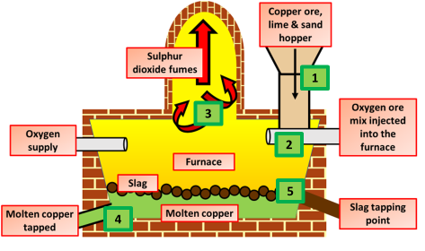

Copper Smelting Question
Describe how copper can be extracted from copper-rich ores using smelting.
_______________________________________________________________________________________________________________________________________________________________________________________________________________________________________________________________________________________________________________________________________________________________________________________________________________________________________
Answer
Link to video

