Slide 1
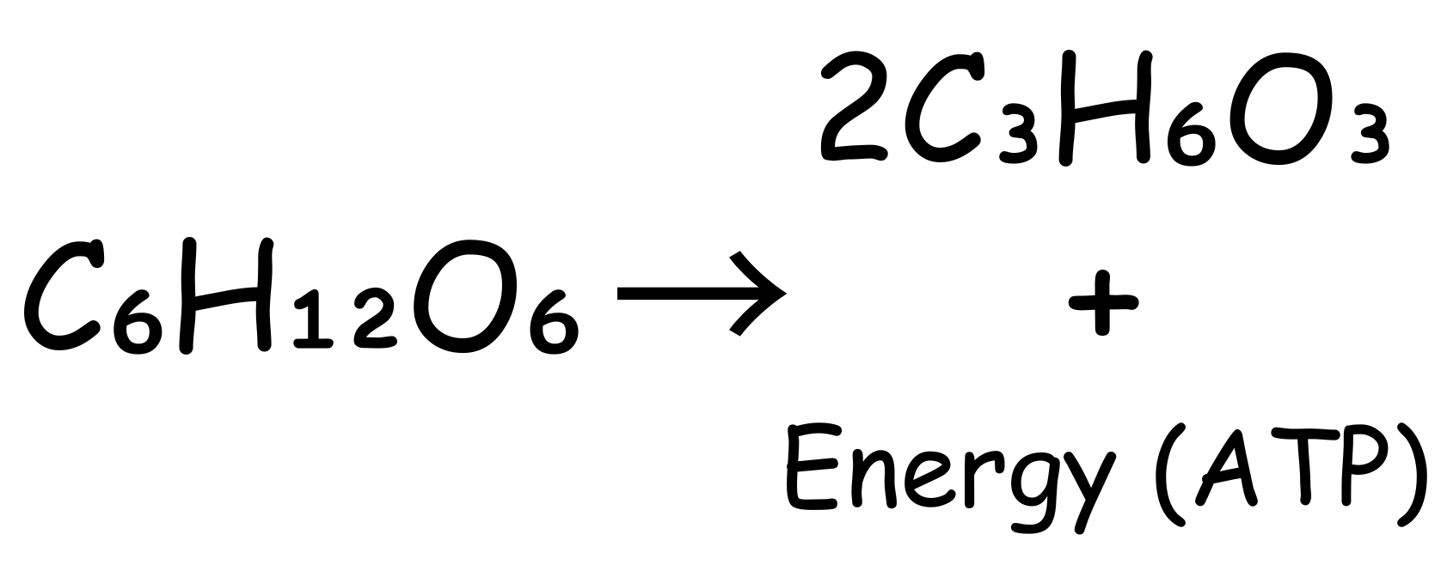

Anaerobic Respiration Question
Explain what happens during anaerobic respiration in human muscle cells and why it is necessary when oxygen is not available.
___________________________________________________________________________________________________________________________________________________________________________________________________________________________________________________________________________________________________________________________________________________________________________________________________________________________________________________________________________________________________________________________________________________________________________________________________________________________________
Answer
Link to video

