Slide 1
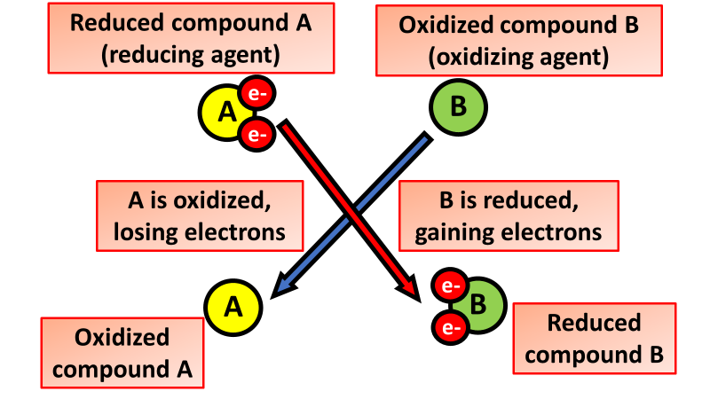

Oxidation Question
Describe what happens during oxidation in terms of electrons and give an example from a chemical reaction.
_______________________________________________________________________________________________________________________________________________________________________________________________________________________________________________________________________________________________________________________________________________________________________________________________________________________________________
Answer
Link to video

