Slide 1
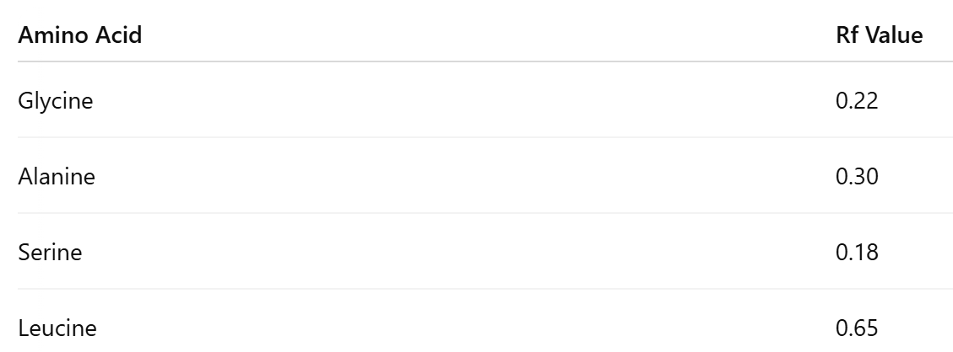

Rf Value of Amino Acids Question
A student carried out paper chromatography on a mixture of amino acids. The following Rf values were recorded for known amino acids:
The unknown Rf value (0.31) is closest to the Rf value for Alanine (0.30).
_______________________________________________________________________________________________________________________________________________________________________________________________________________________________________________________________________________________________________________________________________________________________________________________________________________________________________________________________________________________________________________________________
Answer
Link to video

