Slide 1
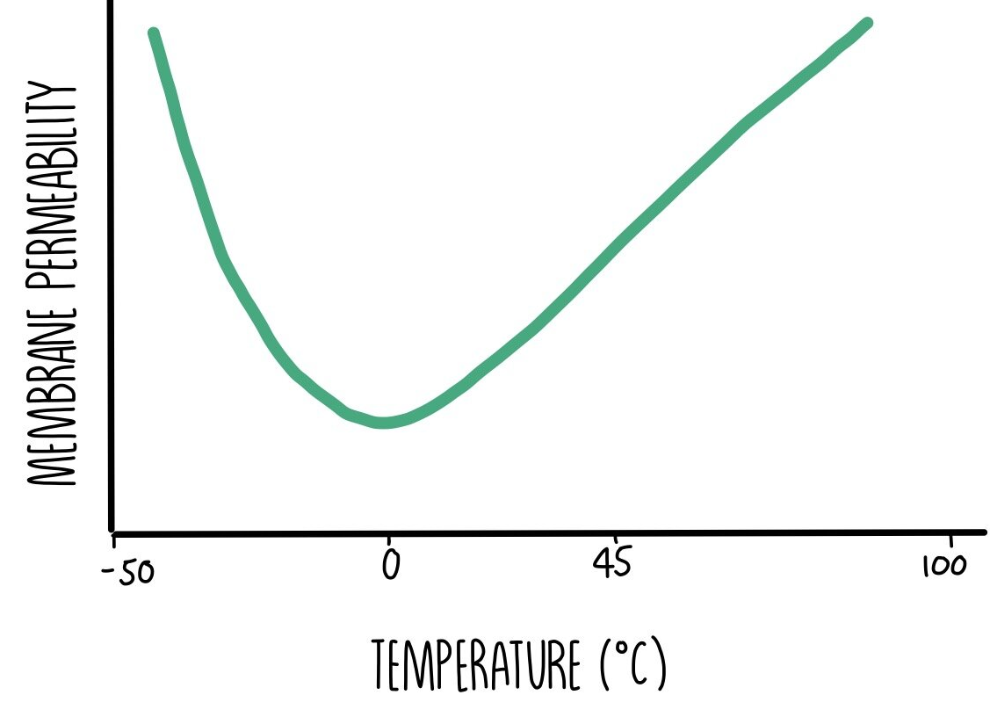

The Effect of Temperature on Membrane Permeability Graph Question
In an investigation, students measured the absorbance of pigment leaked from beetroot cells at different temperatures. Describe and explain the trend you would expect to see on a graph of absorbance against temperature.
_______________________________________________________________________________________________________________________________________________________________________________________________________________________________________________________________________________________________________________________________________________________________________________________________________________________________________
Answer
Link to video

