Slide 1

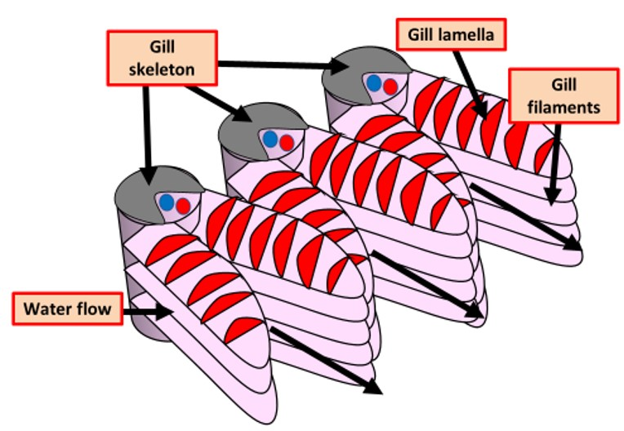

The Great Biology Pubish Quiz
Round 5: Gill Adaptations

Slide 2

The Great Biology Pubish Quiz
Round 5
What is the primary function of gills in fish?
A
To filter impurities from the water
To facilitate gas exchange between water and blood
B
C
To aid in buoyancy
D
To store excess oxygen

Slide 3
The Great Biology Pubish Quiz
Round 5
Which structure within the gills provides a large surface area for gas exchange?
A
Operculum
Gill rakers
B
C
Gill filaments and lamellae
D
Swim bladder

Slide 4
The Great Biology Pubish Quiz
Round 5
How does counter-current flow in fish gills increase the efficiency of gas exchange?
A
By allowing water to flow over the gills faster
By maintaining a concentration gradient between water and blood along the entire gill
B
C
By enabling blood to absorb carbon dioxide from water
D
By reducing water flow over the gills

Slide 5
The Great Biology Pubish Quiz
Round 5
Which gas diffuses from the water into the blood across the gill membranes?
A
Nitrogen
Carbon dioxide
B
C
Oxygen
D
Carbon monoxide

Slide 6
The Great Biology Pubish Quiz
Round 5
In fish, where does deoxygenated blood first come into contact with oxygenated water?
A
At the lamellae in the gill filaments
In the operculum
B
C
In the swim bladder
D
At the gill rakers

Slide 7
The Great Biology Pubish Quiz
Round 5
Why is a continuous flow of water over the gills essential for fish?
A
It helps to clean the gills of waste products
It maximizes oxygen availability for diffusion
B
C
It keeps the gills inflated
D
It allows food particles to reach the gills

Slide 8

The Great Biology Pubish Quiz
Round 5
Question 1
B
Question 2
C
Question 3
B
Question 4
C
Question 5
A
Question 6
B

