Slide 1
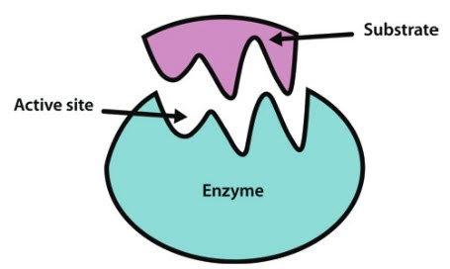

Enzyme Structure Question
Describe the structure of enzymes and explain how this relates to their function.
___________________________________________________________________________________________________________________________________________________________________________________________________________________________________________________________________________________________________________________________________________________________________________________________________________________________________________________________________________________________________________________________________________________________________________________________________________________________________
Answer
Link to video

