Slide 1
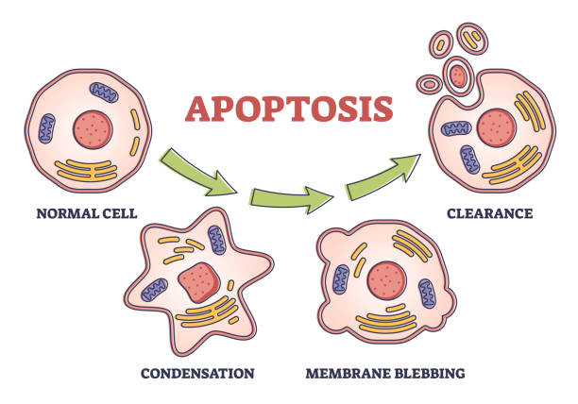
Apoptosis Question
The diagram below shows the process of apoptosis. Describe the process of apoptosis and its importance in organisms.
____________________________________________________________________________________________________________________________________________________________________________________________________________________________________________________________________________________________________________________________________________________________________________________________________________________________________________________________________________________________________________________________________________________________________________________
Answer
Video link

