Slide 1
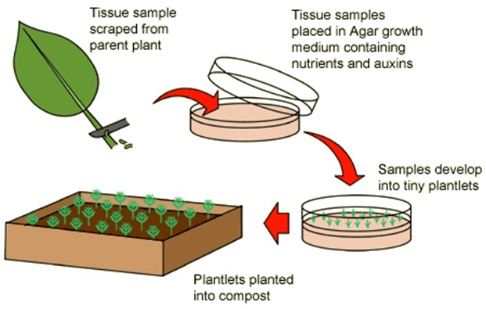

Artificial Plant Cloning Question
Describe how artificial cloning is carried out in plants and explain four key steps or methods used in this process.
____________________________________________________________________________________________________________________________________________________________________________________________________________________________________________________________________________________________________________________________________________________________________________________________________________________________________________________________________________________________________________________________________________________________________________________
Answer
Video link

