Slide 1

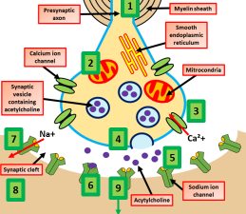
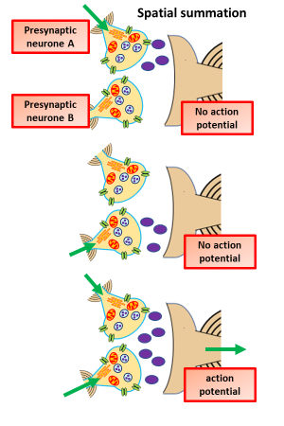
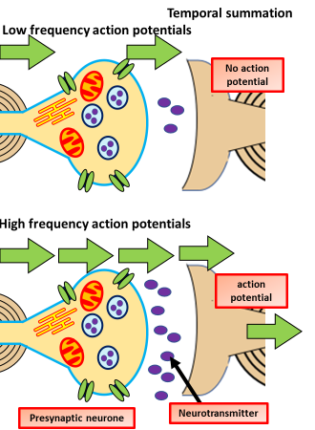
A Level Biology: The Synapse
In the nervous system, a synapse is a structure that permits a neuron (or nerve cell) to pass an electrical or chemical signal to another neuron or to the target efferent cell.
Neurotransmitter a chemical substance which is released at the end of a nerve fibre by the arrival of a nerve impulse and, by diffusing across the synapse or junction, effects the transfer of the impulse to another nerve fibre, a muscle fibre, or some other structure.
Excitatory: When an action potential arrives at the synapse's presynaptic terminal button, it may stimulate the release of neurotransmitters. These neurotransmitters are released into the synaptic cleft to bind onto the receptors of the postsynaptic membrane and influence another cell, either in an inhibitory or excitatory way.
Inhibitory Neurotransmitters. These neurotransmitters result in the hyperpolerisation of the post synaptic membrane. This prevents an action potential being triggered.
1
The action potential reaches the end of the presynaptic neurone
Temporal summation is where a high frequency of action potentials in the presynaptic neuron elicits postsynaptic potentials that overlap and summate with each other. The effect is generated by a single neuron as a way of achieving action potential.
2
Depolarisation of the presynaptic membrane causes calcium ion channels to open
3
Calcium ions diffuse into the presynaptic knob
4
This causes synaptic vesicles containing neurotransmitter to fuse with the presynaptic membrane
Spatial summation is a way of achieving an action potential in a neuron with input from multiple presynaptic cells. Spatial summation is the algebraic summation of potentials from different areas of input, usually on the dendrites.
5
Neurotransmitter is released into the synaptic cleft by exocytosis
The Role of Synapses
They ensure impulses are unidirectional. As the neurotransmitter receptors are only present on the postsynaptic membrane, impulses can only travel from the presynaptic neurone to the postsynaptic neurone
They can allow an impulse from one neurone to transmitted to a number of neurones at multiple synapses. This results in a single stimulus creating a number of simultaneous responses.
Alternatively, a number oi neurones may feed in same synapse with a single postsynaptic neurone results in stimuli from different receptors interact produce a single result.
The neurotransmitter diffuses across the synaptic cleft and binds with it’s specific receptor molecule on the postsynaptic membrane
6
7
This causes sodium channels to open
8
Sodium ions diffuse into the postsynaptic neurone
9
This triggers an action potential and the impulse is propagated along the post synaptic neurone

