Slide 1
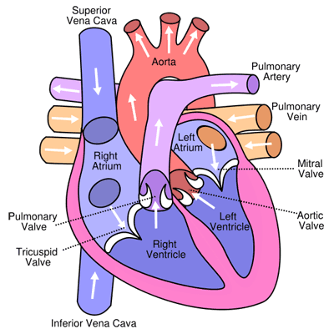
The Heart Practice Question
Specification Link:
Transport Systems
Highlight key words in the information below:
The heart is divided longitudinally into two sides by means of muscular walls.
Each atrium is connected to its own ventricle through an opening which is guarded by a valve. Blood is permitted to flow only from the atrium into the ventricle, not in the reverse direction. The right valve (the tricuspid valve) is made up of three flaps. The left valve (the bicuspid valve or the mitral valve) has two flaps.
The semi-lunar valve can be found where the heart connects with both the aorta and pulmonary artery.
What regulates how the heart beats?
____________________________________________________________________________
The sino-atrial node (the pace maker) is a specialized bundle of thin, cardiac, muscular fibers buried in the right atrial wall, near the connection between the right auricle and the large veins
The sino-atrial node sends impulses over the two atria which are then stimulated to contract. When the electrical impulses reach the atrioventricular node (at the junction between the atria and the ventricles), the impulses will spread rapidly through special fibers from the inter-ventricular septum to the walls of both ventricles, where the muscles are stimulated to contract.
What is the role of the sino-atrial node?
____________________________________________________________________________
How do nerve impulses spread around the heart?
____________________________________________________________________________
The heart has an increasing rhythmic activity. It pumps blood through the process of contraction and relaxation. The contraction of the heart is called ‘systole’ and the relaxation is called ‘diastole’. The contraction and relaxation together constitute the heartbeat. The heart beats at an average rate of 70 beats per minute. The changes that occur in the heart during a beat are repeated in the same order in the next beat, and the next one. This cyclical repetition is called the cardiac cycle. During the cardiac cycle, blood flows through the cardiac chambers in a specific manner and direction, the backward flow being prevented by the valves.
What is systole?
____________________________________________________________________________
What is diastole?
____________________________________________________________________________
What happens during the cardiac cycle?
__________________________________________________________________________________________________________________
Describe the rhythm of the heart in detail
________________________________________________________________________________________________________________________________________________________________________________________________________________________________________________________________________________________________________________________________________________________________________________________________________________________________________________________________________________________________________________________________________________________________________________________________________________________________________________________________________________________________________

Slide 2
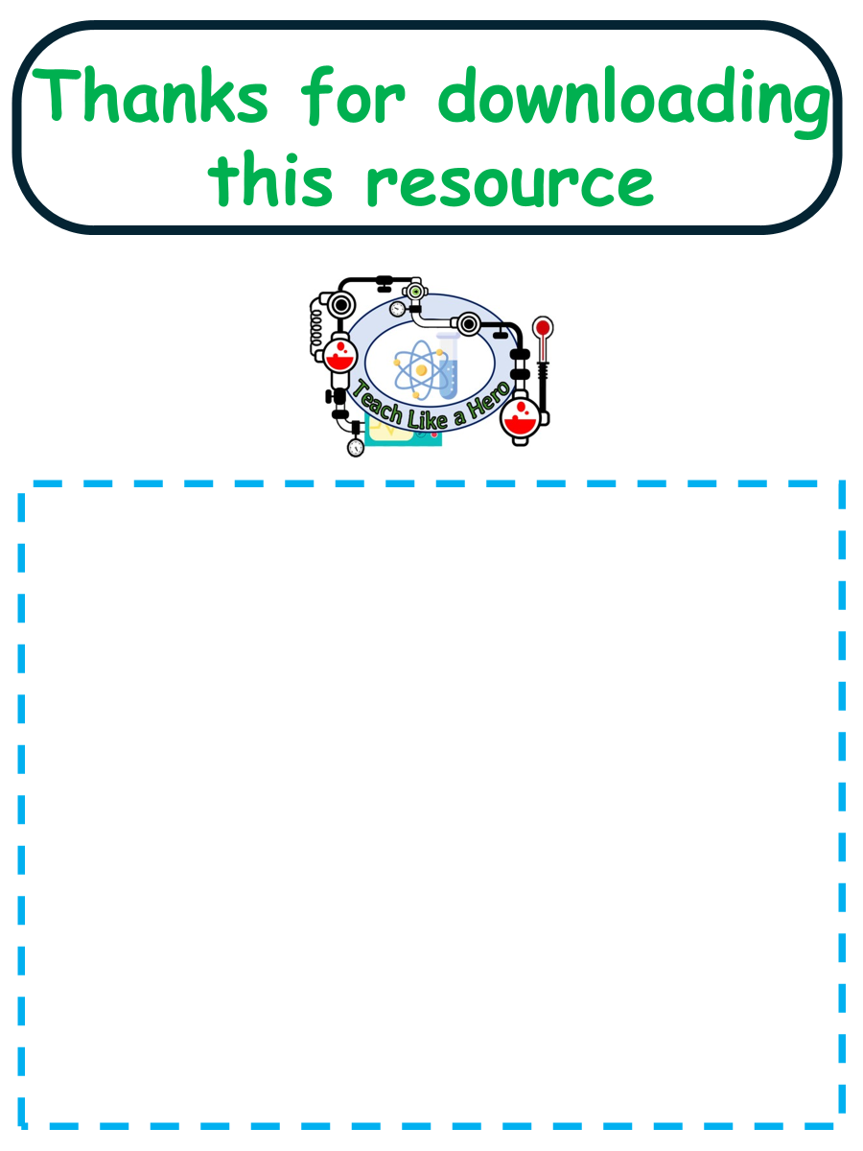
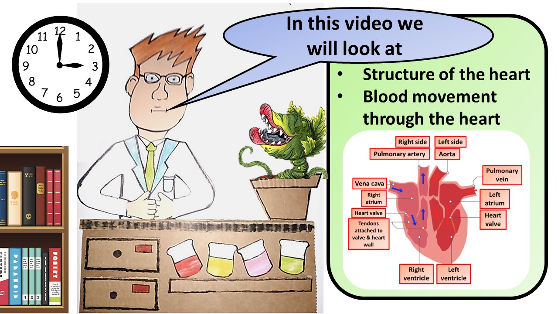


Click here to access my percentage composition youtube videos
Resources that this activity would work well with
Lesson on TES
Lesson on TPT
Follow me on social media to stay in touch
Keep up to date with my new content:

