Slide 1


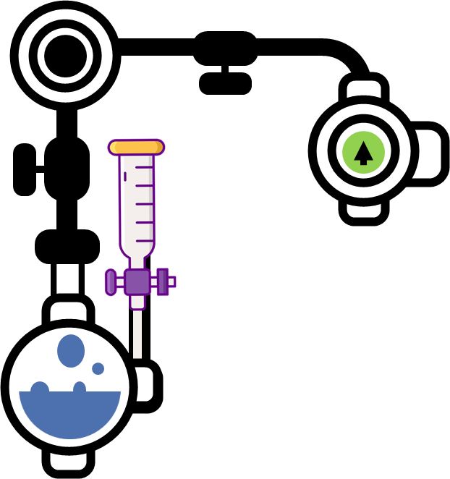

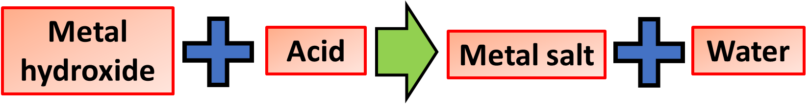
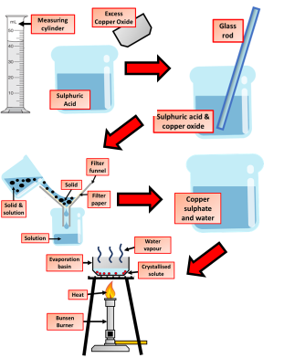


Acids & Bases Notes
Acids form acidic solutions in water. Acids are sources of hydrogen ions , H +. For example, hydrochloric acid produces hydrogen ions: HCl(aq) → H +(aq) + Cl -(aq) Acidic solutions have pH values less than 7.
A substance that will neutralise an acid, but does not dissolve in water, is called a base. For example, copper(II) oxide, iron(II) oxide and zinc carbonate are bases, they do not dissolve in water.
A neutralisation reaction is a reaction between an acid and a base. Remember:
acids in solution are sources of hydrogen ions, H+
alkalis in solution are sources of hydroxide ions, OH-
In acid-alkali neutralisation reactions, hydrogen ions from the acid react with hydroxide ions from the alkali:
H+(aq) + OH-(aq) → H2O(l)
Strong and weak acids
Hydrochloric acid, nitric acid and sulfuric acid are described as strong acids. Strong acids react vigorously with metals and bases. They are also considered to be corrosive
Weak acids react more slowly and less vigorously with metals and bases.
Weak acids include citric acid (found in lemon juice), lactic acid (found in yoghurt) and ethanoic acid (found in vinegar).
Making Salts Practical
Add powdered insoluble reactant to acid in a beaker, one spatula at a time, stirring to mix. Continue adding powder until it is in excess (some unreacted powder is left over).
Filter the mixture in the beaker to remove the excess powder. Collect the filtrate.
Pour the filtrate into an evaporating basin. Place on a water bath, and heat until about half the water from the solution has been removed by evaporation. Stop heating when small crystals start to appear around the edge of the evaporating basin.
Pour the remaining solution into a watch glass, and leave in a warm, dry place for crystallisation to occur.
If necessary, dry the crystals by dabbing gently with filter paper.
Dilute and concentrated solutions
A solution forms when a solute dissolves in a solvent. The concentration of a solution is a measure of how 'crowded' the solute particles are. The more concentrated the solution, the more particles it contains in a given volume.
When solutions are described as dilute or concentrated:
a dilute solution contains a relatively small amount of dissolved solute
a concentrated solution contains a relatively large amount of dissolved solute
Take care to use the word 'dilute' correctly. It can be used as an adjective to describe the concentration of a solution (as here), or as a verb to describe the process of adding more water to a solution to decrease its concentration.
Neutralisation Investigation
Use a measuring cylinder to add dilute hydrochloric acid to a beaker.
Dip a clean glass rod into the contents of the beaker. Use it to transfer a drop of liquid to a piece of universal indicator paper on a white tile. Wait 30 seconds, then match the colour to a pH colour chart. Record the estimated pH.
Add a level spatula of calcium hydroxide powder to the beaker.
Stir thoroughly, then estimate and record the pH of the mixture (as in step 2).
Repeat steps 3 and 4 until there are no more changes in pH.

Slide 2

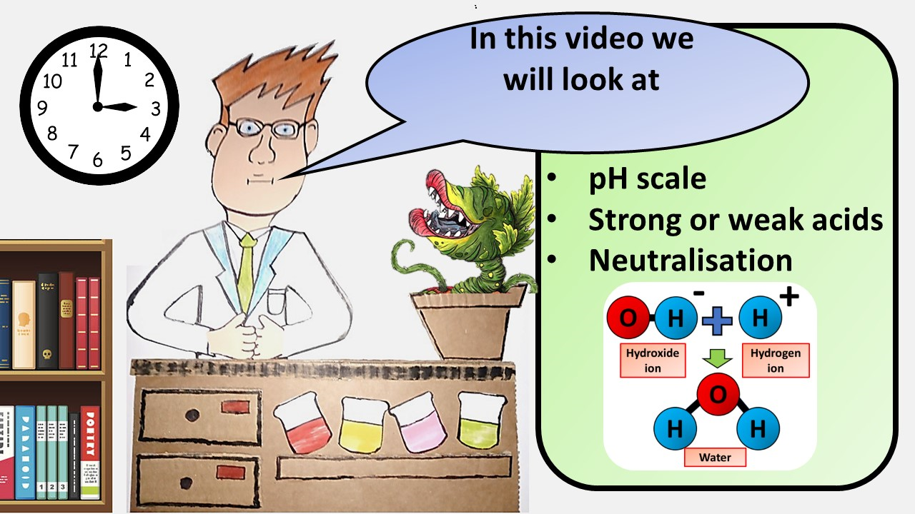


Click here to access my youtube videos
Resources that this activity would work well with
Lessons on TES
Lessons on TPT
Follow me on social media to stay in touch
Keep up to date with my new content:

