Slide 1
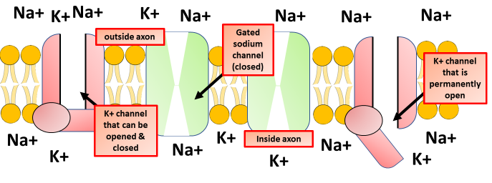
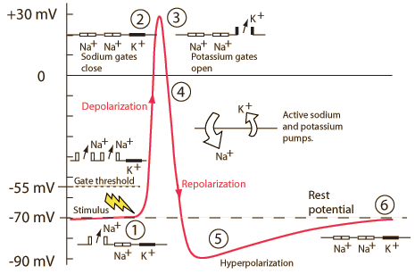
Action Potential Question
Specification Link
Neuronal Communication
Highlight key words in the information below:
The action potential is a rapid change in polarity that moves along the nerve fibre from neuron to neuron.
In order for a neuron to move from resting potential to action potential—a short-term electrical change that allows an electrical signal to be passed from one neuron to another—the neuron must be stimulated by pressure, electricity, chemicals, or another form of stimuli.
The level of stimulation that a neuron must receive to reach action potential is known as the threshold of excitation, and until it reaches that threshold, nothing will happen. Different neurons are sensitive to different stimuli, although most can register pain.
The diagram above shows a section of the neuronal membrane. Explain what happens during depolarization.
____________________________________________________________________________________________________________________________________________________________________________________________________________________________________________________________________________________________________________________________________________________________________________________________________________________________________________________________________________
Depolarization: A stimulus starts the depolarization of the membrane. Depolarization, also referred to as the "upswing," is caused when positively charged sodium ions rush into a nerve cell. As these positive ions rush in, the membrane of the stimulated cell reverses its polarity so that the outside of the membrane is negative relative to the inside.
Repolarization. Once the electric gradient has reached the threshold of excitement, the "downswing" of repolarization begins. The channels that let the positive sodium ion channels through close up, while channels that allow positive potassium ions open, resulting in the release of positively charged potassium ions from the neuron. This expulsion acts to restore the localized negative membrane potential of the cell, bringing it back to its normal voltage.
Refractory Phase. The refractory phase takes place over a short period of time after the depolarization stage. Shortly after the sodium gates open, they close and go into an inactive conformation. The sodium gates cannot be opened again until the membrane is repolarized to its normal resting potential. The sodium-potassium pump returns sodium ions to the outside and potassium ions to the inside. During the refractory phase this particular area of the nerve cell membrane cannot be depolarized. Therefore, the neuron cannot reach action potential during this "rest period."
Describe what is shown in the graph above
__________________________________________________________________________________________________________________________________________________________________________________________________________________________________________________________________________________________________________________________________________________________________________________________________________________________________________________________________________________________________________

Slide 2
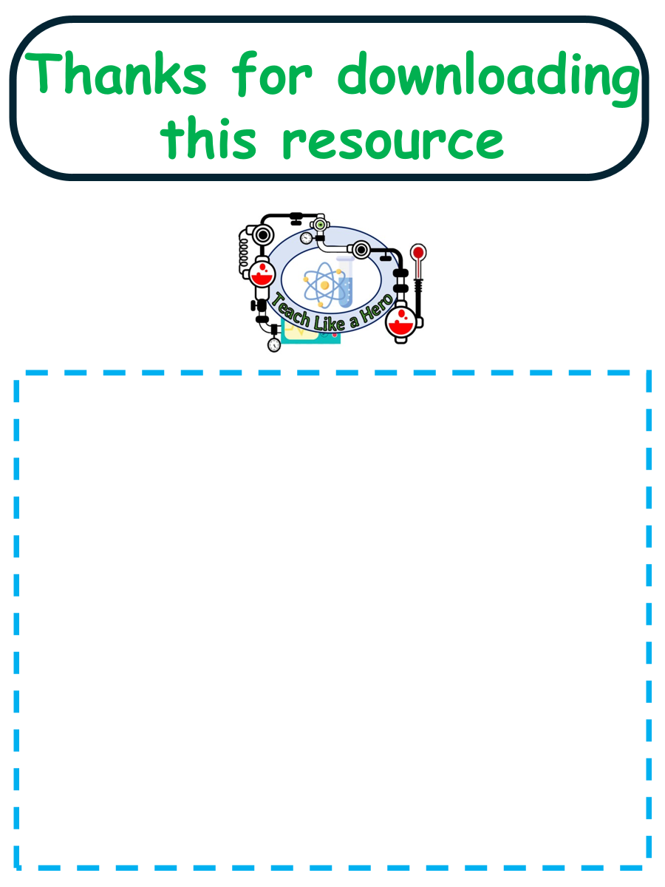
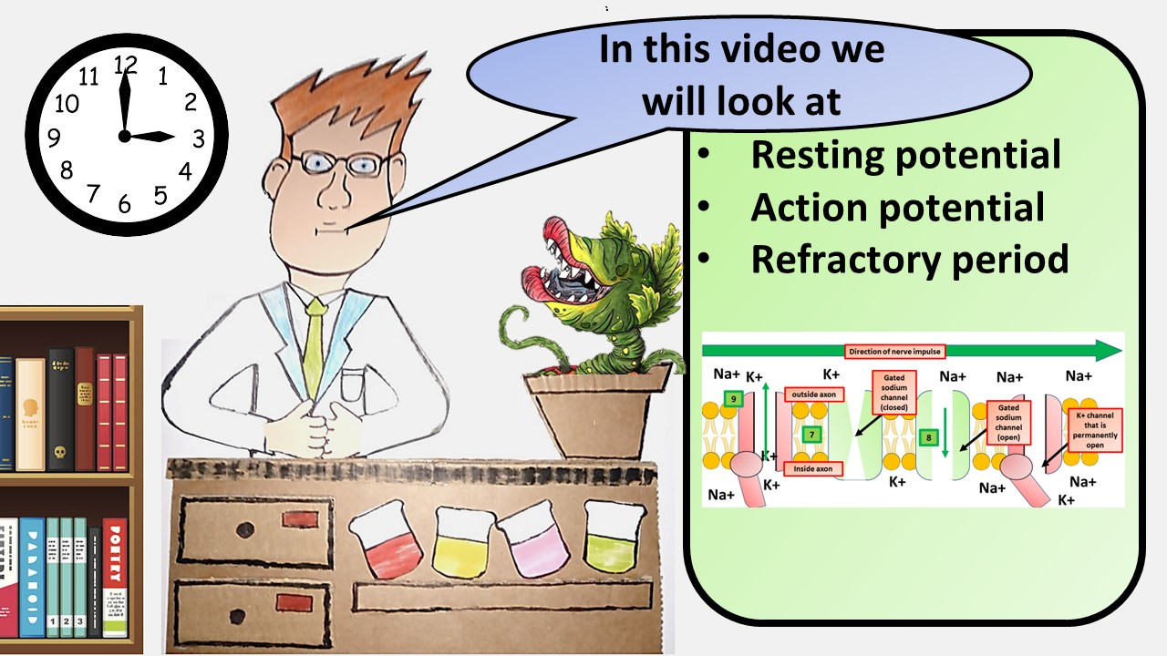


Click here to access my percentage composition youtube videos
Resources that this activity would work well with
Lesson on TES
Lesson on TPT
Follow me on social media to stay in touch
Keep up to date with my new content:

