Slide 1
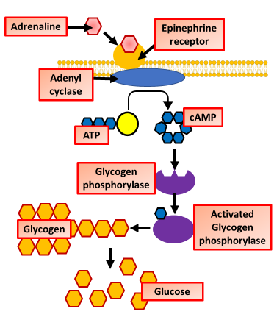
Adrenaline Question
Specification Link:
Hormonal Communication
Highlight key words in the information below:
Epinephrine is an important cell signaling molecule in the fight or flight response. Also known as adrenaline, epinephrine is an efficient messenger that signals many cell types throughout the body with many effects. In the lungs, epinephrine binds to receptors on smooth muscle cells wrapped around the bronchioles. This causes the muscles to relax, dilating the bronchioles and allowing more oxygen into the blood. At the sino-atrial node of the heart, epinephrine stimulates pace maker cells to beat faster. This increases the rate at which other chemical signals, glucose and oxygen are circulated to the cells that need them. Epinephrine also contracts specific types of muscle cells below the surface of the skin, causing beads of perspiration and raised hairs at the surface.
In terms of cell signaling, name the compound in the diagram that is acting as the first messenger and the compound that is acting as the second messenger.
______________________________________________________________________________________________________________________________________________________________________________________________________________________________________________________________________________________________________________________________________________________
How does adrenaline trigger cell signaling within a cell?
________________________________________________________________________________________________________________________________________________________________
How is cAMP formed and what role does it play?
________________________________________________________________________________________________________________________________________________________________
Adrenaline affects a range of target tissues in the body. Suggest how the adrenaline molecules can cause different effects in different target tissues.
______________________________________________________________________________________________________________________________________________________________________________________________
Key actions of adrenaline include increasing the heart rate, increasing blood pressure, expanding the air passages of the lungs, enlarging the pupil in the eye (see photo), redistributing blood to the muscles and altering the body's metabolism, so as to maximise blood glucose levels (primarily for the brain).
What role does adrenaline play in the flight or fight response?
____________________________________________________________________________________________________________________________________________________________________________________________________________________________________________________________________________________________________________________________________________

Slide 2

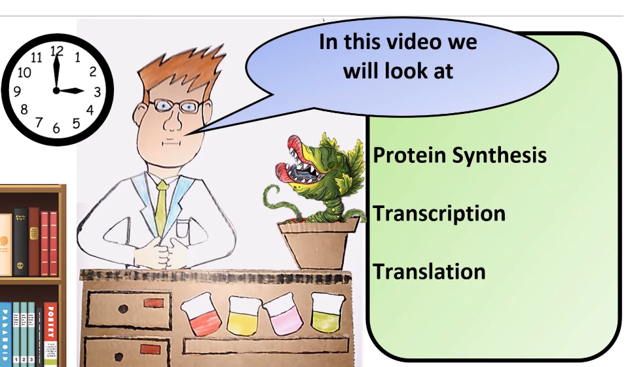


Click here to access my percentage composition youtube videos
Resources that this activity would work well with
Lesson on TES
Lesson on TPT
Follow me on social media to stay in touch
Keep up to date with my new content:

