Slide 1
Alcohols, Carboxylic acids and Esters Practice Question
What are the issues involves in the use of alcohols, carboxylic acids and esters? (Could be worded as just alcohols etc)
Alcohol
alcoholic drinks help people relax
too much puts people’s health at risk
can damage liver, require a liver transplant or even kill
may become addicted, cause behaviour changes
alcoholics may drink ‘meths’ which causes liver failure, blindness and an early death
alcoholic drinks are expensive due to taxes on them
antisocial behaviour caused by excessive drinking
Answer
Ethanol and esters as biofuels:
ethanol can be used to make biofuel
Biodiesel is made from esters
Land used for biofuel crops could be used for food crops
We need fuel and food but feeding is a primary requirement
New farming land often provided for by chopping down the rainforest in countries like Brazil
Destroys habitats and biodiversity
Leading to increased carbon dioxide and global warming

Slide 2

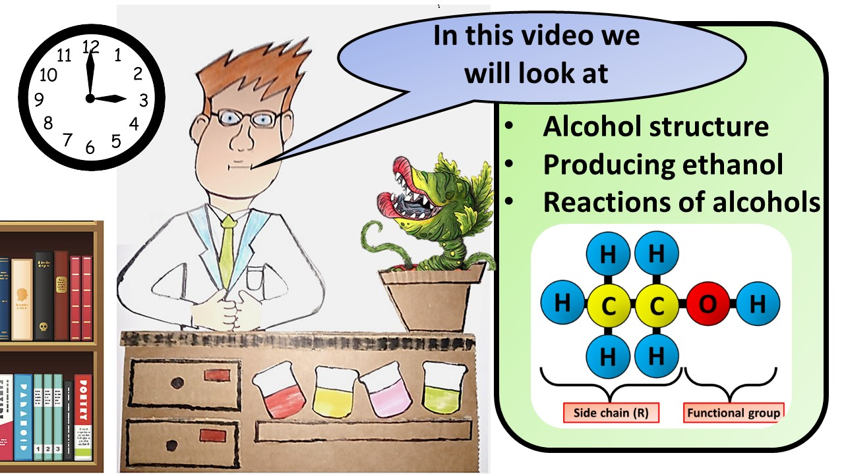


Click here to access my youtube videos
Resources that this activity would work well with
Lesson on TES
Lesson on TPT
Follow me on social media to stay in touch
Keep up to date with my new content:

