Slide 1
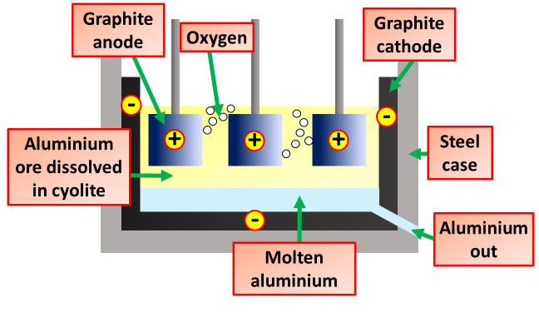
Electrolysis of Aluminium Question
Specification Link:
Chemical Change: 4.4.3.3
Highlight key words in the information below:
Aluminium is the most abundant metal on Earth. Aluminium ore is called bauxite. The bauxite is purified to yield a white powder, aluminium oxide, from which aluminium can be extracted. The extraction is done by electrolysis. But first the aluminium oxide must be made molten so that electricity can pass through it.
Electrolysis is the process of breaking up chemicals using electricity. Bauxite is purified to produce aluminium oxide. This is then mixed with cryolite to lower the melting point. A positive and negative electrode is placed into this mix. The aluminium gains a positive charge. The oxygen gains a negative charge. The aluminium moves towards the negative electrode. The oxygen moves towards the positive electrode
Why is cyolite added ?
______________________________________________________________________________________________
What charge do the oxygen & aluminium ions get?
______________________________________________________________________________________________
Describe how aluminium is produced by electrolysis
____________________________________________________________________________________________________________________________________________________________________________________________________________________________________________________________________________________________________________________________________________________________________________________________________________
What happens to oxygen ions at the positive electrode?
______________________________________________________________________________________________
What happens to the aluminium at the negative electrode?
______________________________________________________________________________________________
Why do the graphite anodes need replacing often?
______________________________________________________________________________________________
Why can aluminium not be extracted by heating aluminium oxide with carbon?
________________________________________________________________________________________________________________________
Reactivity Series
Calcium
Give two reasons why aluminium should be recycled.
____________________________________________________________________________________________________________________________________________________________________________________________________________________________________________________________________________________________________________
Magnesium
Aluminium
Carbon
Describe how the equipment to the left could be used to measure the rate of photosynthesis:
_______________________________________________________________________________________________________________________________________________________________________________________________________________________________________________________________

