Slide 1
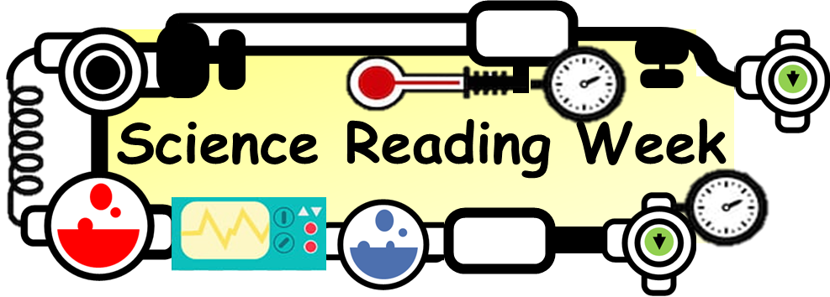
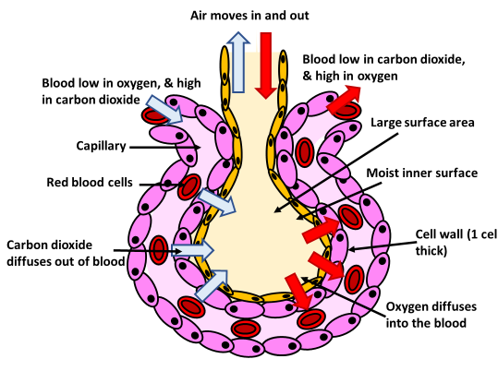
Alveoli Article
Have you ever wondered how we breathe? It's all thanks to tiny air sacs in our lungs called alveoli! These little wonders play a big role in helping us take in oxygen and get rid of carbon dioxide.
Here's how it works: When we breathe in, air travels down our windpipe and into our lungs. Inside our lungs, the air reaches millions of tiny alveoli, which look like clusters of grapes. These alveoli are surrounded by tiny blood vessels called capillaries.
Now, let's talk about gas exchange. When we breathe in, oxygen from the air enters the alveoli and passes through their thin walls into the capillaries. At the same time, carbon dioxide from our blood moves into the alveoli to be breathed out.
It's like a little dance happening inside our lungs! Oxygen goes in, and carbon dioxide comes out, all thanks to the amazing alveoli.
But wait, there's more! The walls of the alveoli are lined with a sticky substance called surfactant, which helps keep them open and prevents them from collapsing. This allows us to breathe easily and efficiently.
So the next time you take a deep breath, remember to thank your alveoli for their incredible work. They may be small, but they play a big role in keeping us alive and kicking!
Questions
What gases are exchanged in the lungs?
What are the alveoli surrounded by?
Are the walls of the alveoli thick or thin?
What are the walls of the alveoli coated in?
What gas do we breath out?

